Slide 1
User Datagram Protocol
(UDP)

Slide 2
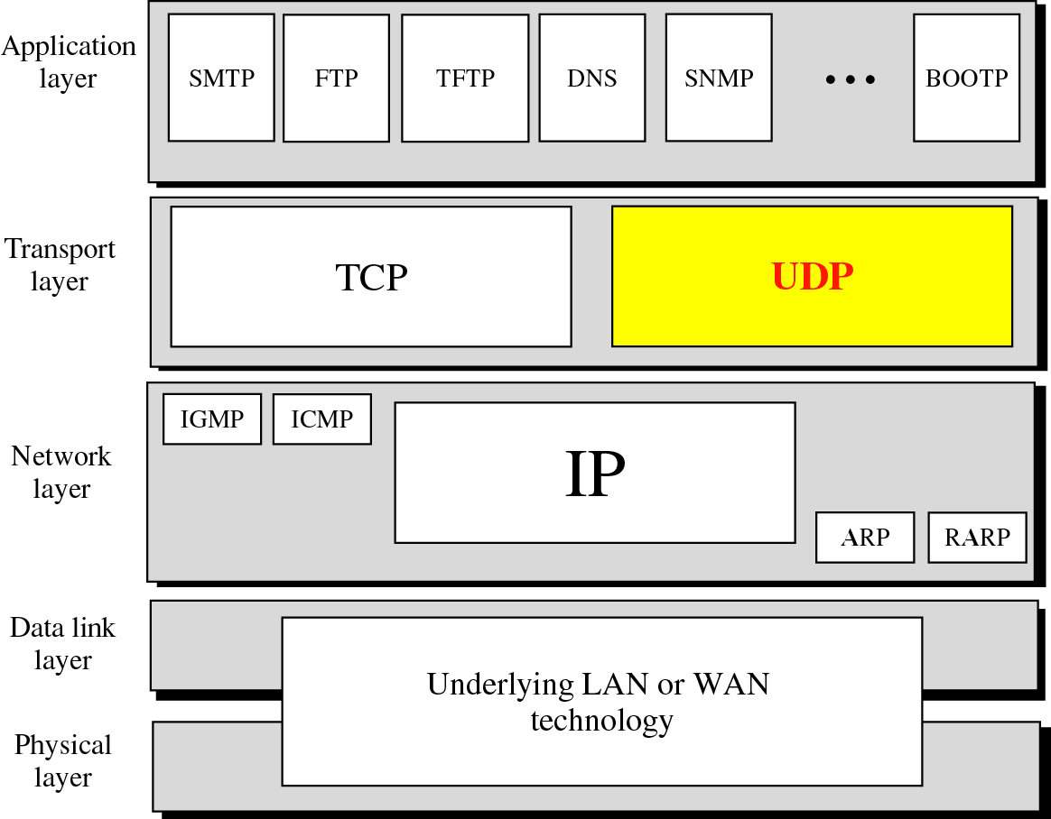
Position of UDP in the TCP/IP protocol suite

Slide 3
User Datagram Protocol
Takes care of process to process communication.
Connectionless and Unreliable.
Very limited error checking
Minimum overhead.

Slide 4
PROCESS
TO
PROCESS
COMMUNICATION

Slide 5
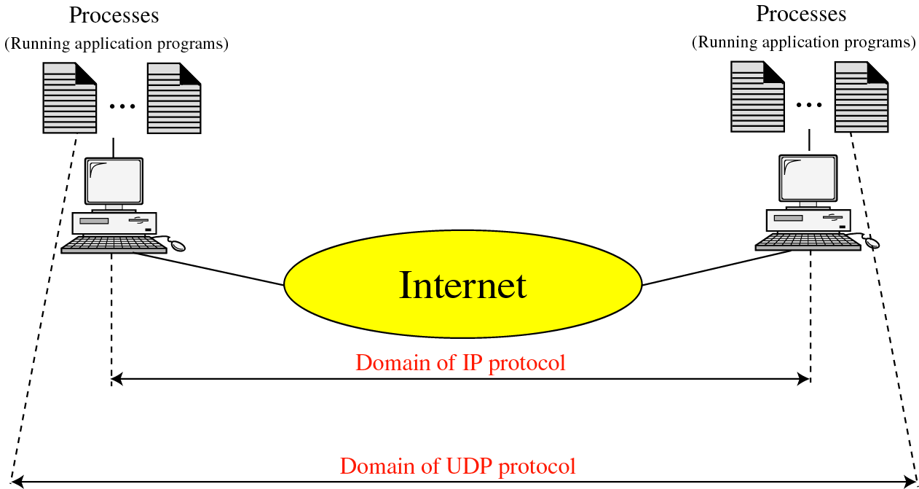
UDP versus IP

Slide 6
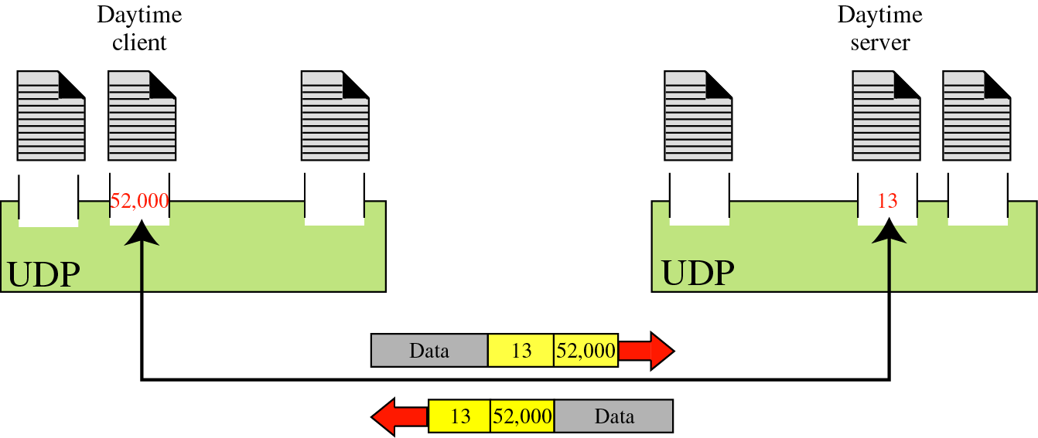
Port Numbers
Ephemeral and Well known port numbers.

Slide 7
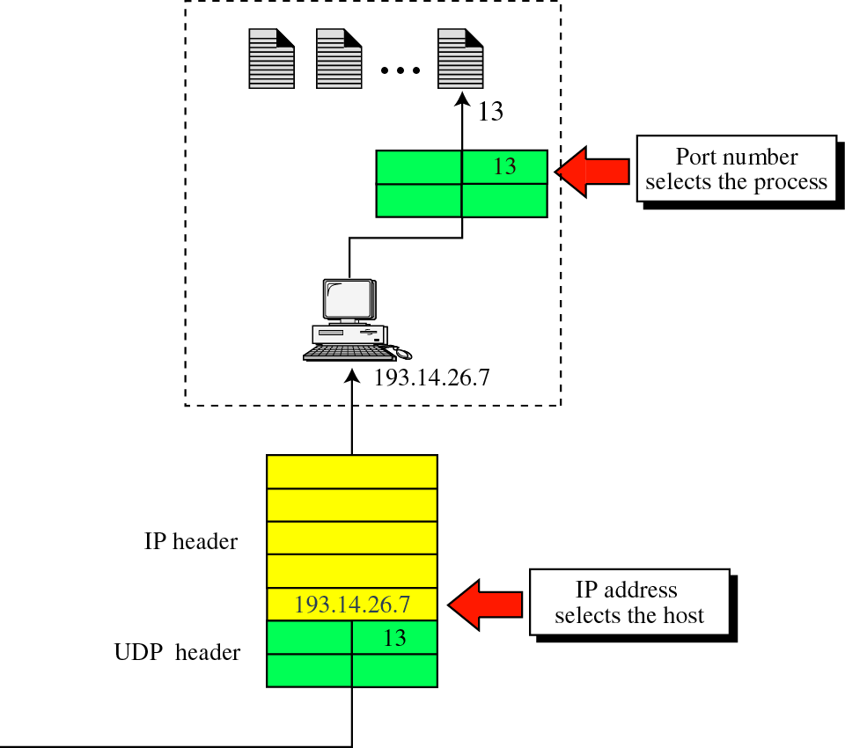
IP Addresses Versus Port Numbers

Slide 8
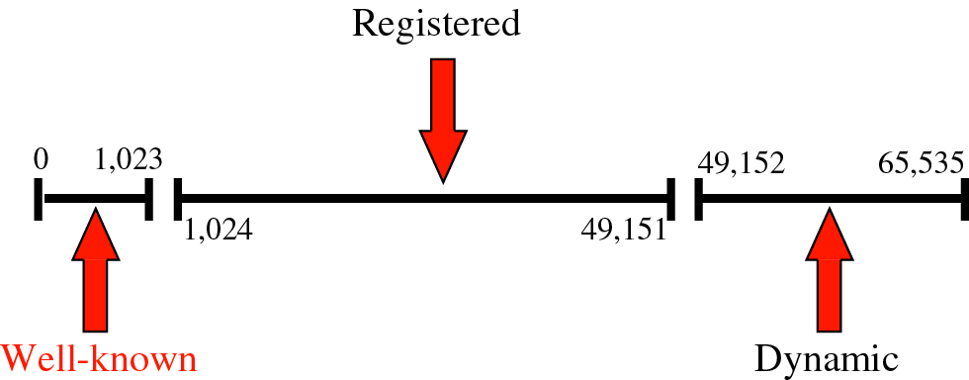
IANA Ranges
(Internet Assigned Number Authority )

Slide 9
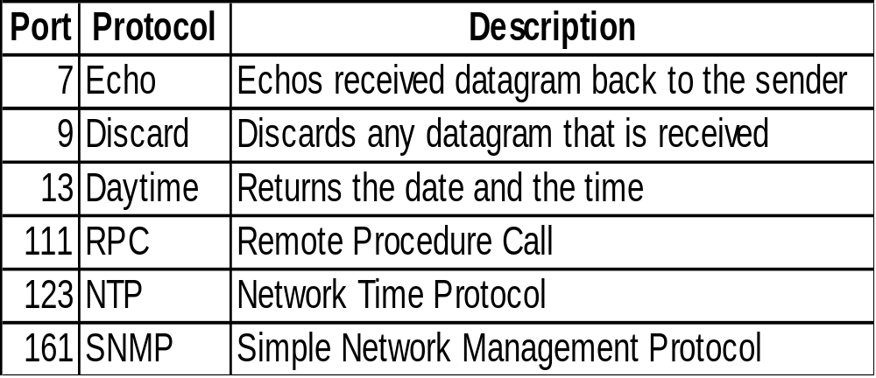
Well-Known Port Numbers

Slide 10
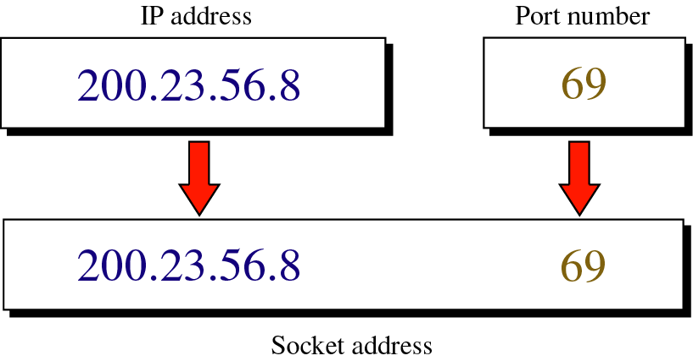
Socket Addresses

Slide 11
USER
DATAGRAM

Slide 12
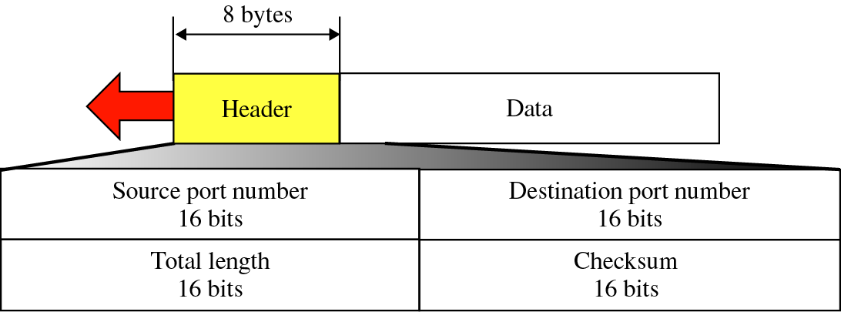
User Datagram Format

Slide 13

UDP length =
IP length − IP header’s length

Slide 14
UDP
OPERATION

Slide 15
Connectionless services
Error Control
Flow Control
Encapsulation and decapsulation

Slide 16
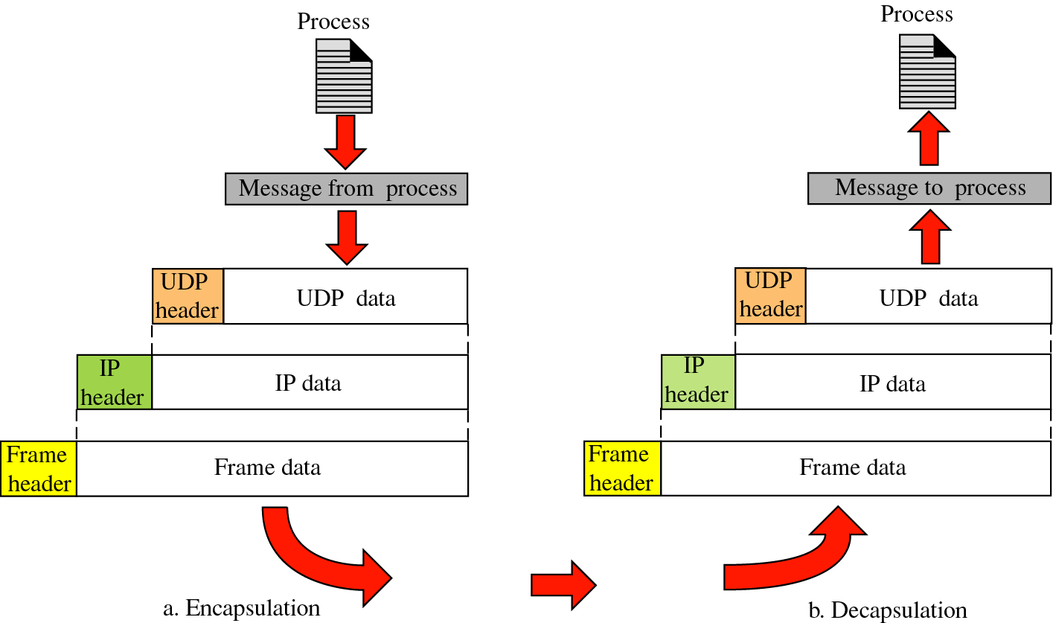

Slide 17
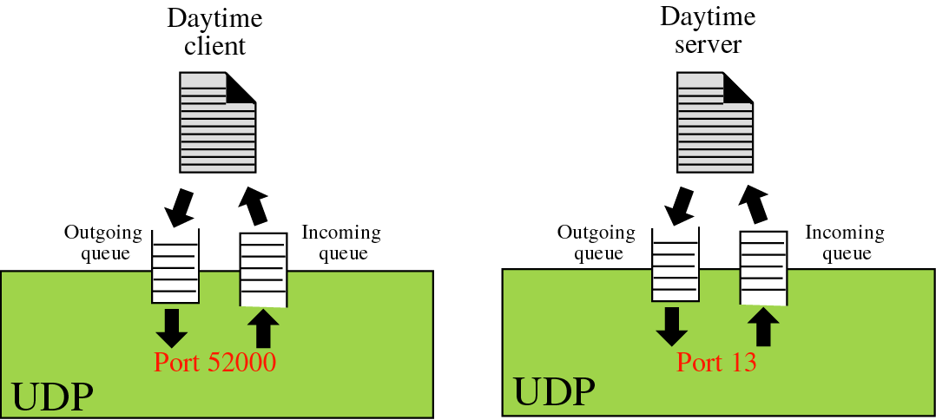
Queues in UDP

Slide 18
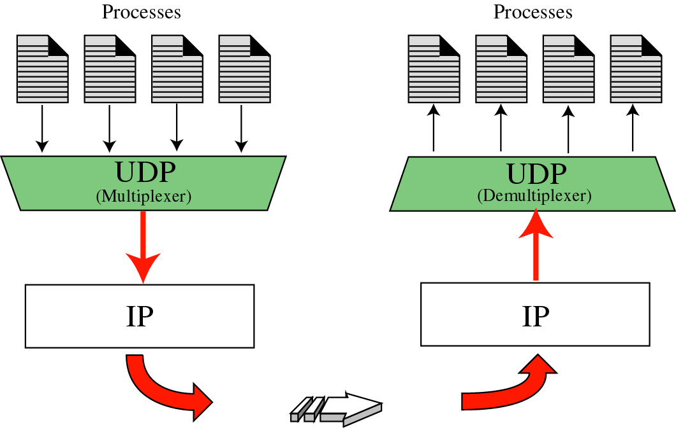
Multiplexing and Demultiplexing

Slide 19
Use of UDP
Its suitable for a process that requires simple request-response communication.
Its suitable for a process with internal flow and error control.
Used for management process such as SNMP.
Used for some route updating protocols such as Routing Information Protocol (RIP).
UDP is a suitable transport protocol for multicasting. Multicasting capability is embedded in the UDP software but not in the TCP software.

